Slide 1
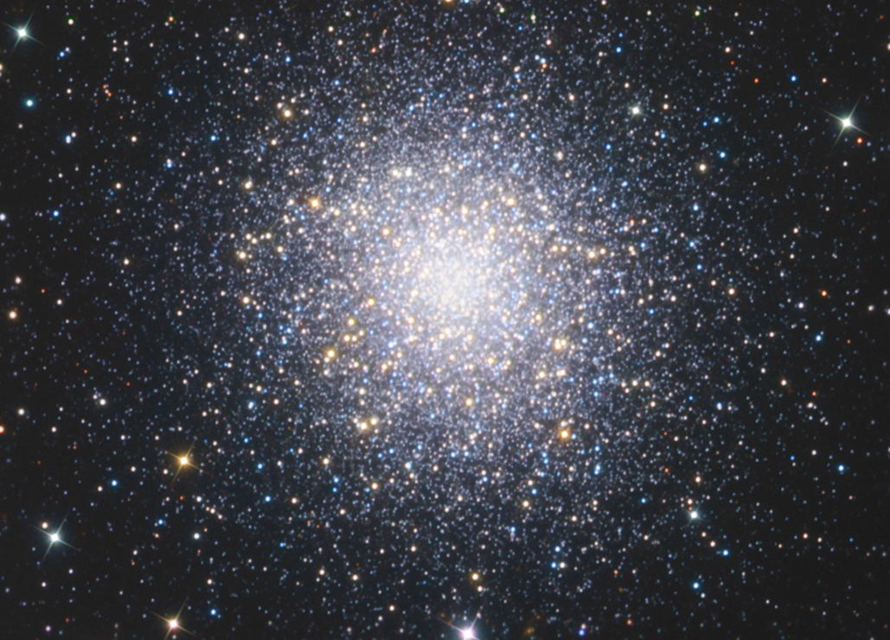
M15 Globular Cluster

Slide 2
A globular cluster is a spherical collection of stars that orbits
a galactic core as a satellite. Globular clusters are very tightly
bound by gravity, which gives them their spherical shapes
and relatively high stellar densities toward their centers.

Slide 3
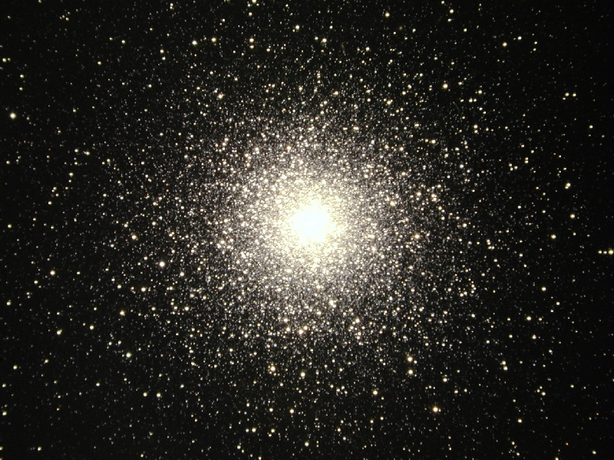
 | Pegasus
 | 21h 29m 58.33s
 | +12° 10′ 01.2″
 | 7078
 | 39,000 Light Years
Apparent magnitude (V) | +6.5
 | Globular Cluster
Apparent size (V) | 12’

Slide 4
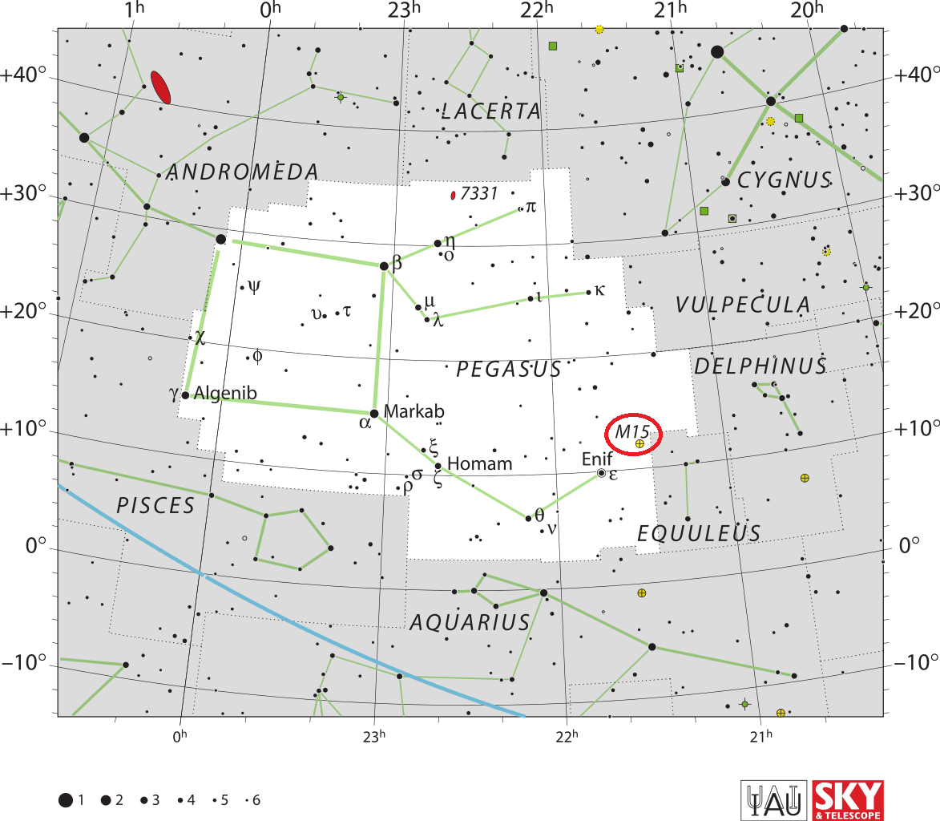

Slide 5
To effectively resolve
M15 At least a 10 inch
10 telescope should
be used.

Slide 6
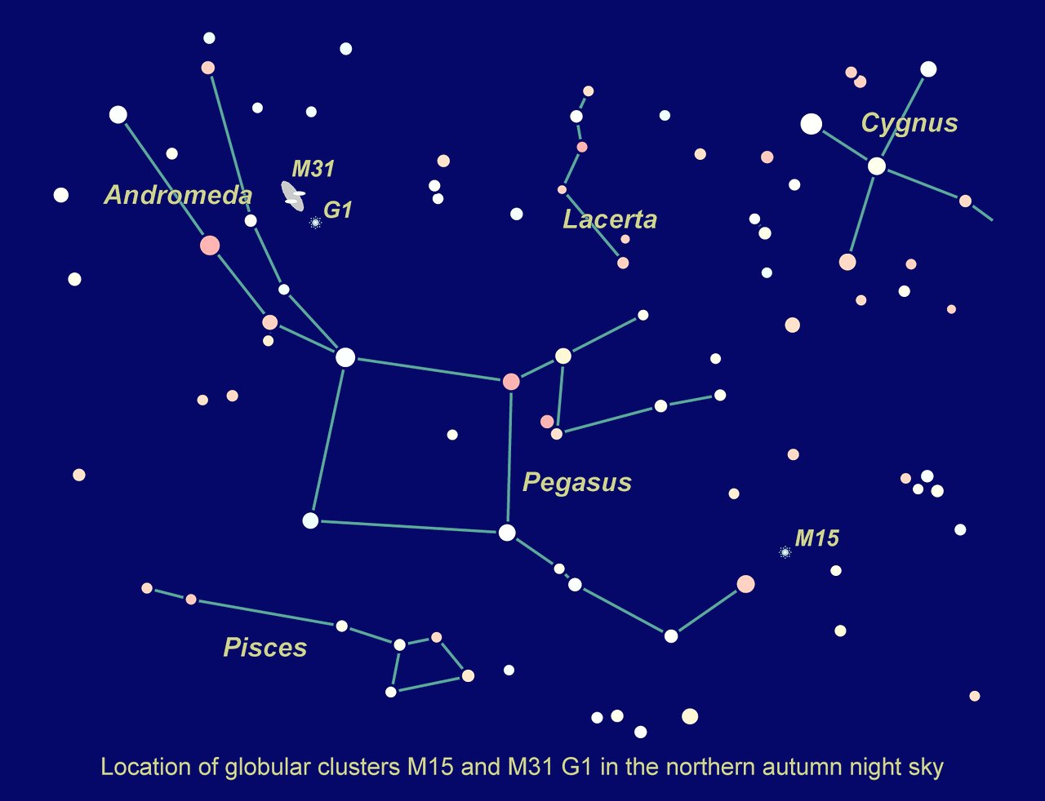

Slide 7
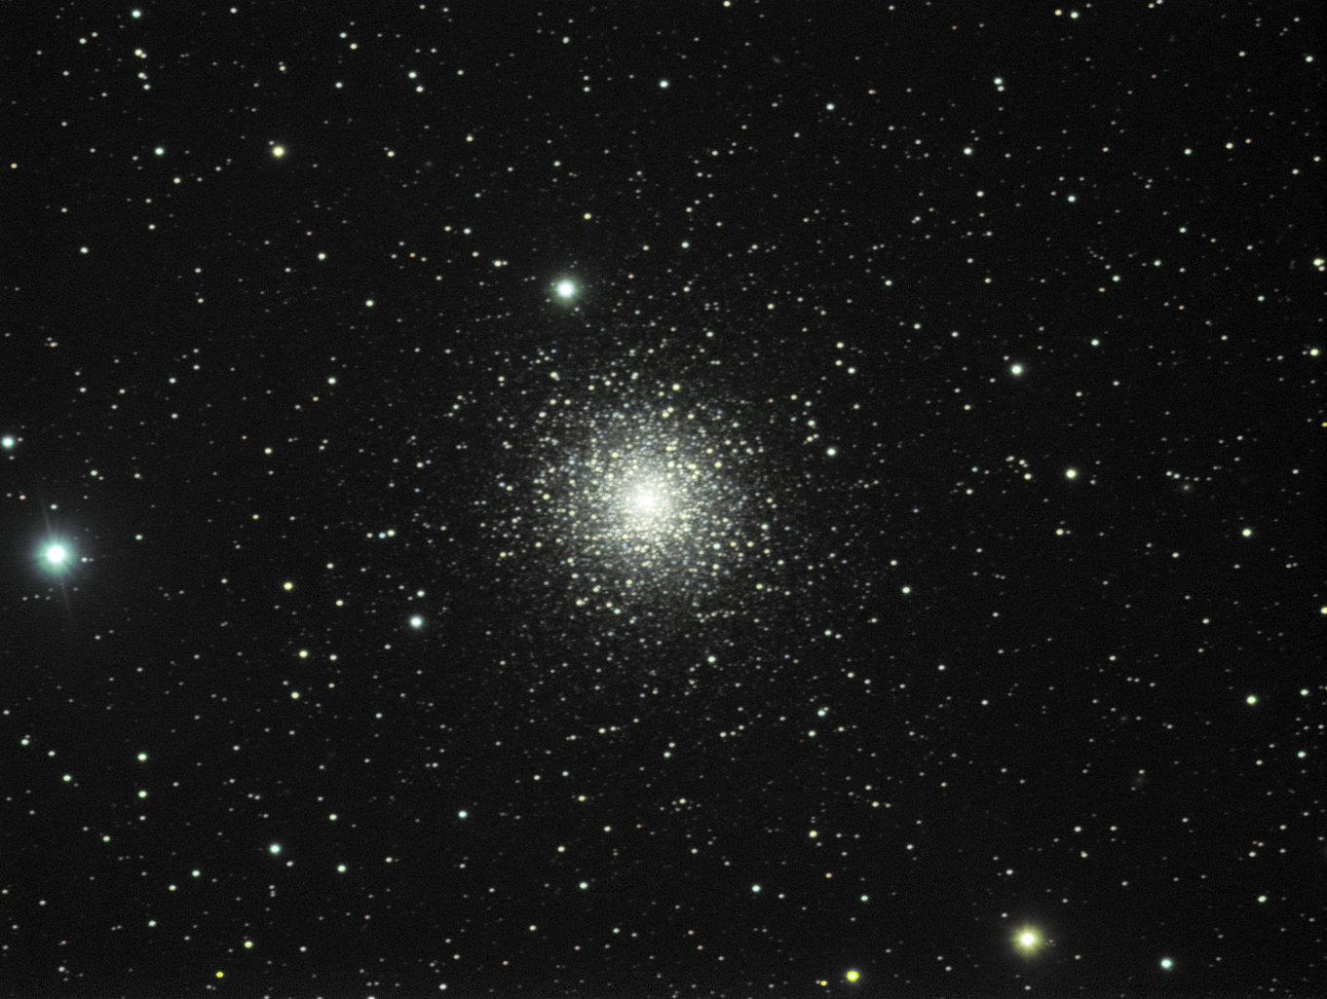
At magnitude 6.2, M15 approaches naked eye visibility under good conditions and can be observed with binoculars or a small telescope, appearing as a fuzzy star. Telescopes with a larger aperture will start to reveal individual stars, the brightest of which are of magnitude +12.6. The cluster appears 18 arc minutes in size.

Slide 8
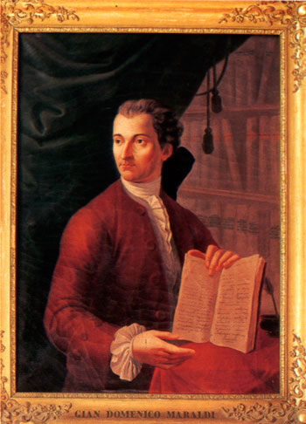
It was discovered by Jean-Dominique Maraldi in 1746 and included in Charles Messier's catalogue of comet-like objects in 1764. At an estimated 12.0 billion years old, it is one of the oldest known globular clusters.

